Slide 1
FINANCE AND risk analytics
PRITHVIRAJ PATIL

Slide 2

Agenda
Problem Description
Inferences and Visualization
Sector Analysis
Correlation Among Stocks
Top 8 Stocks
Methodology
Portfolio Analysis

Slide 3

Problem Description
Analyzing stock portfolio for investment advice based on client requirements.
Two clients: Mr. Patrick Jyenger and Mr. Peter Jyenger.
Mr. Patrick Jyenger:
Investing $500K in equities.
Conservative investor seeking low-risk approach.
Aiming to double capital within 5 years.
Mr. Peter Jyenger:
Investing $1 million in equities.
High-risk investor with preference for high returns.
Goal of doubling capital within 5 years.

Slide 4
Inferences and visualization

Slide 5
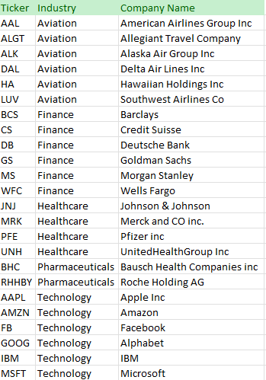
Stocks Data Overview:
24 stocks in total from four sectors, with 6 stocks per sector.
Available index for comparison: S&P500, comprising the top 500 US stocks.

Slide 6
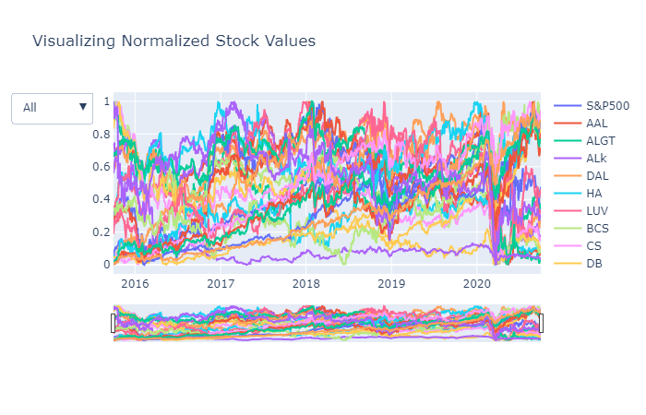
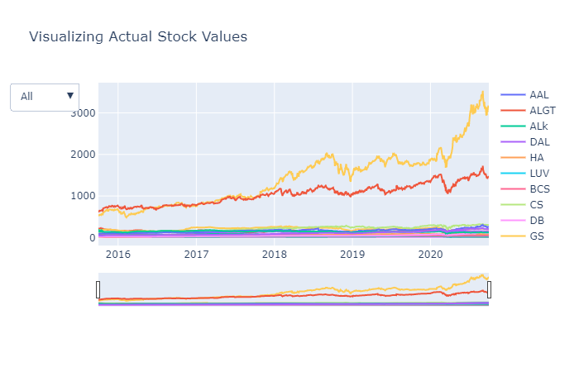
VISULIZATION OF STOCKS:
Actual Stock Values
Normalized Stock Values
Stock Performance Over 5 Years:
The chart depicted above illustrates the performance of all stocks throughout the past 5 years. It is evident from the chart that Amazon and Google have demonstrated the most impressive performance over this period when compared to other stocks.
Stocks vs. S&P500 Index:
The graph presented above offers a comparative view of stock performance against the S&P500 index. Notably, the chart reveals that 8 stocks have achieved returns exceeding 80% by the conclusion of the 5-year period.

Slide 7

Sector Analysis

Slide 8
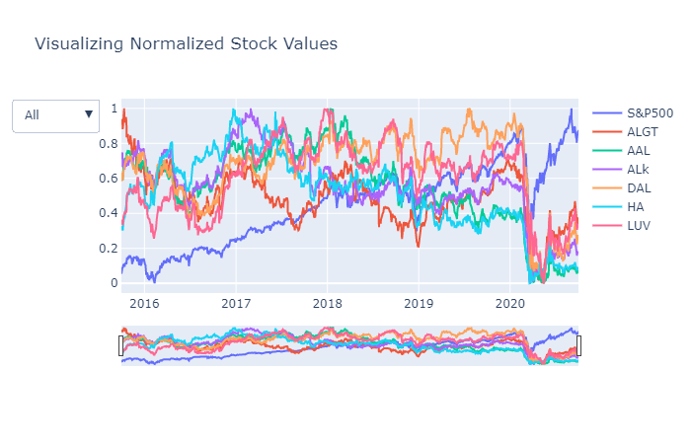
Aviation Sector
Stocks were consistently moving sideways.
The Aviation sector faced a major crisis in March 2020 due to the COVID-19 pandemic.
The Aviation sector has not recovered since then, despite the market index recovering.

Slide 9
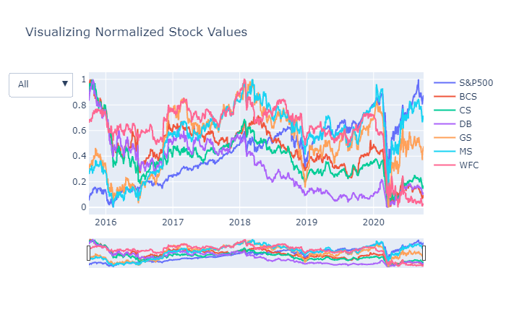
Finance Sector
Finance sector faced a significant crisis in March 2020 due to the COVID-19 pandemic.
The sector has shown partial recovery, although most stocks were impacted.
Notably, Morgan Stanley & Goldman Sachs performed well compared to other stocks.

Slide 10
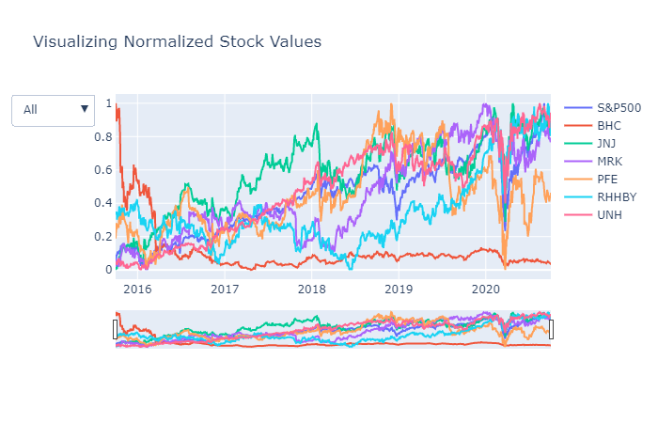
Pharma & Healthcare Sector
The Pharma & Health care sector experienced a significant crisis due to the COVID-19 pandemic in March 2020.
This sector has demonstrated remarkable recovery since then.
Notably, United Health and Johnson & Johnson have shown strong performance compared to the S&P Index.
Conversely, Bausch Health has consistently underperformed in comparison to other stocks in the same sector.

Slide 11
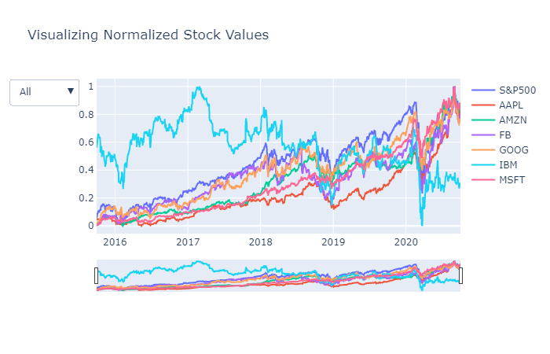
Technology Sector
The Technology Sector was significantly impacted by the Covid-19 pandemic in March 2020.
Despite the crisis, this sector has demonstrated an impressive recovery.
Leading companies like Microsoft, Amazon, Apple, Facebook, and Google have performed well, aligning with the market index.
On the other hand, IBM has consistently underperformed compared to other stocks in the same sector.

Slide 12
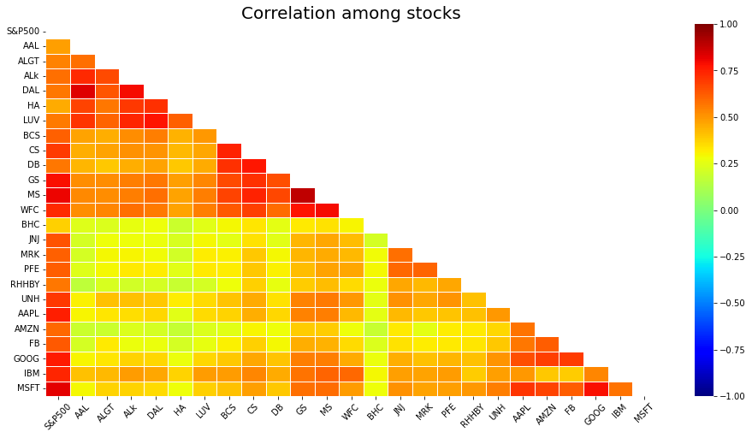
Correlation among stocks
Microsoft and Google stocks exhibit a high correlation within the Technology sector.
In the Finance sector, Goldman Sachs, Morgan Stanley, and Wells Fargo are correlated.
Within the Aviation sector, American Airlines and Delta Airlines show stronger correlation than Alaska Air Group.
The Pharma sector stocks demonstrate lower correlation compared to stocks from other sectors.

Slide 13
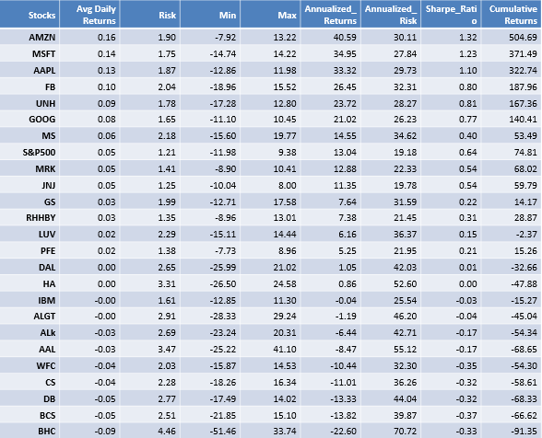
Top 8 Stocks with Returns Greater Than 80% at the End of 5 Years
Annual Returns of Selected Stocks:
AMZN: 40.59%
MSFT: 34.95%
AAPL: 33.32%
FB: 26.45%
UNH: 23.72%
GOOG: 21.02%
MS: 14.55%
S&P500: 13.04%

Slide 14



Methodology

Slide 15
Exploratory Data Analysis:
Checked for Null Values: No columns have null values in the dataset.
Outlier Analysis: Checked for outliers in the dataset.
Data Analysis:
Calculated daily returns, cumulative daily return, Sharpe ratio, Portfolio risk, and Return on Investment (ROI).
Identified the best-suited stocks for all portfolios.
Inferences from Data Analysis:
Identified 8 stocks with over 80% returns in the last five years.
Best-performing stocks: AMZN, MSFT, AAPL, FB, UNH, GOOG, MS, S&P500.
Each stock carries varying risk and liability based on Annualized risk and Sharpe ratio.
AMZN offers high returns but comes with high risk.
Stocks like JNJ, RHHBY, MRK, and MSFT offer good returns with lower risk.
Based on analysis, finalized portfolios for both customers.

Slide 16
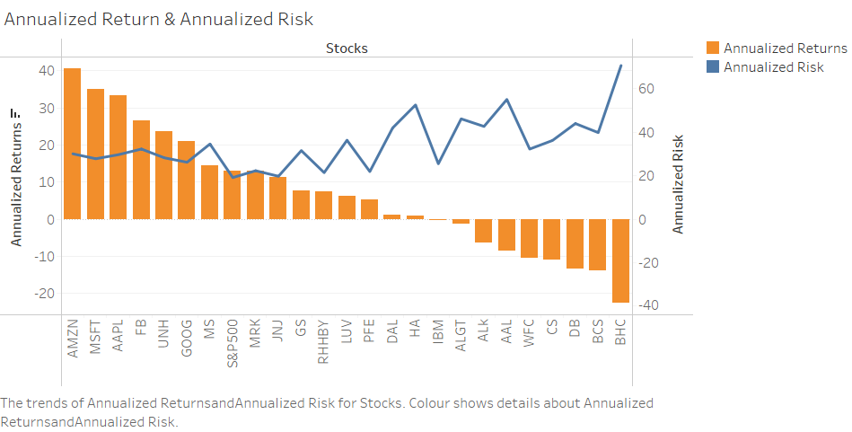
Annualized Return & Annualized Risk
Top Five Stocks Analysis:
The annualized returns of the top five stocks are: AMZN, MSFT, AAPL, FB, UNH.
All these top five stocks have annualized returns of over 20%.
The risk associated with these stocks is at a medium level compared to other stocks.
Lower returns increase the likelihood of losing the initial investment.
BHC, BCS, DB, CS, and WFC have higher risk as they didn't provide returns on the initial investment.
Lower ROI indicates higher risk in stocks. However, some stocks may not offer high returns but provide a risk-free investment opportunity.
JNJ, RHHBY, MRK are stocks with less risk and good returns.

Slide 17
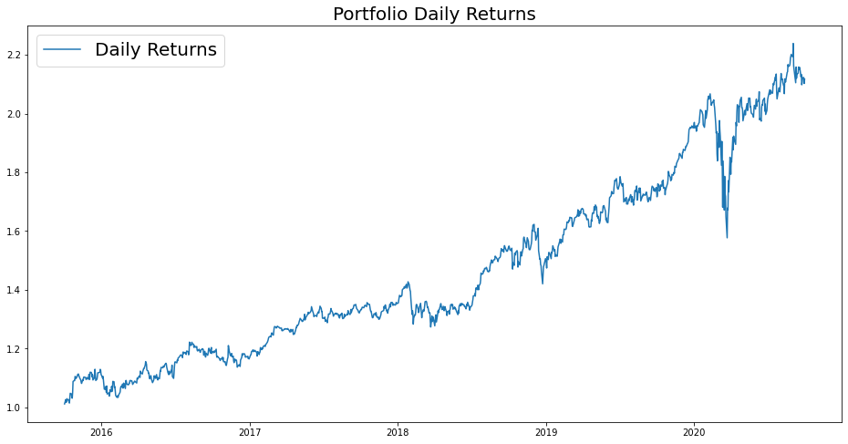
Patrick JyengAr Portfolio analysis
Investment Goal: Double the investment in 5 years with decent returns and low risk.
Preferred Stocks: JNJ, RHHBY, MRK are suitable due to their low risk.
However, these three stocks wouldn't alone reach the desired returns.
A portion of the investment can be allocated to MSFT to achieve the target returns.
Equal weightage of 0.25 is allocated to all stocks.
Investment: $500,000 in equities.
Expected Returns: $1.05 million after 5 years.
Gain on Investment: $558,230.

Slide 18
Peter JyengAr Portfolio analysis
Investment Goal: High-return investments for inorganic expansion of the company, accepting high risk.
Preferred Stock: AMZN, suitable due to its high-risk/high-reward nature.
Believes in bouncing back from occasional losses.
Investment: $1 million from company's cash and cash equivalents.
Expected Returns: More than $6 million after 5 years.
Gain on Investment: More than $5 million.
Focus on maximum returns and managing associated risk.

Slide 19




Thank you
PRITHVIRAJ PATIL

